Slide 1
Presentation of ECO
7 October 2018 - Tehran
Presentation by
Memduh UNAL
Director of Agriculture, Industry and Tourism of ECO

Slide 2
Contents of the Presentation
I. Economic Cooperation Organization in a Nutshell
Economic and Demographic Indicators
LIFD Countries in the ECO Region
Dependency on Natural Resources
Commodity Price
Some Facts
II. Agriculture Sector in the ECO Region
III. ECO Regional Program for Food Security (ECO-RPFS)
IV. Combating Transboundary Animal Diseases
V. Future Activities

Slide 3
I. Economic Cooperation Organization in a Nutshell
Economic Cooperation Organization (ECO)
A 10-Member intergovernmental regional organization
470 million population and over 8 million sq. km territory
Abundant historical, cultural and natural resources
Great potential in expanding the regional cooperation in the field of agriculture
Afghanistan Azerbaijan Iran Kazakhstan Kyrgyz Republic
Pakistan Tajikistan Turkey Turkmenistan Uzbekistan

Slide 4
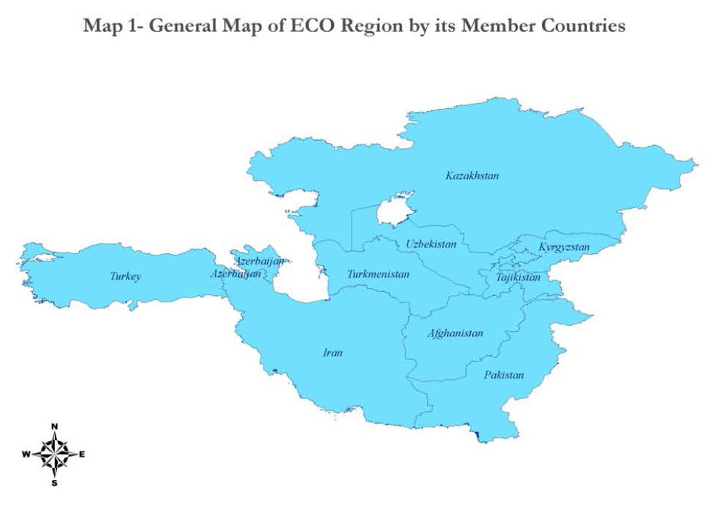

Slide 5
Key Economic and Demographic Indicators of ECO Countries (2016)
 | GNP Per Capita PPP $ | Population Million | Agr Value Added % GDP | Agr Emp % | Rural Pop %
Afghanistan | 1970 | 35 | 21.0 | 61.3 | 75.0
Azerbaijan | 16120 | 10 | 5.6 | 36.3 | 45.0
Iran | 20010 | 80 | 9.6 | 18.0 | 26.1
Kazakhstan | 22900 | 18 | 4.6 | 17.9 | 42.7
Kyrgyzstan | 3380 | 6 | 12.8 | 26.8 | 64.1
Pakistan | 5560 | 193 | 23.2 | 42.3 | 63.8
Tajikistan | 3500 | 9 | 20.4 | 50.7 | 73.1
Turkmenistan | 24980 | 6 | 6.2 | 19.5 | 25.9
Turkey | 16430 | 80 | 9.3 | 8.4 | 49.3
Uzbekistan | 6640 | 31 | 16.1 | 22.0 | 49.4
ECO | 10757 | 467 | 16.4 | 31.0 | 53.2
World | 16190 | 7467 | 3.5 | 26.8 | 45.6

Slide 6
LIFD Countries in the ECO Region
According to FAO
In 2001: Afghanistan, Azerbaijan, Kyrgyzstan, Pakistan, Tajikistan, Turkmenistan, and Uzbekistan
In 2015: Afghanistan, Kyrgyzstan, Tajikistan, and Uzbekistan
In 2020: ?

Slide 7
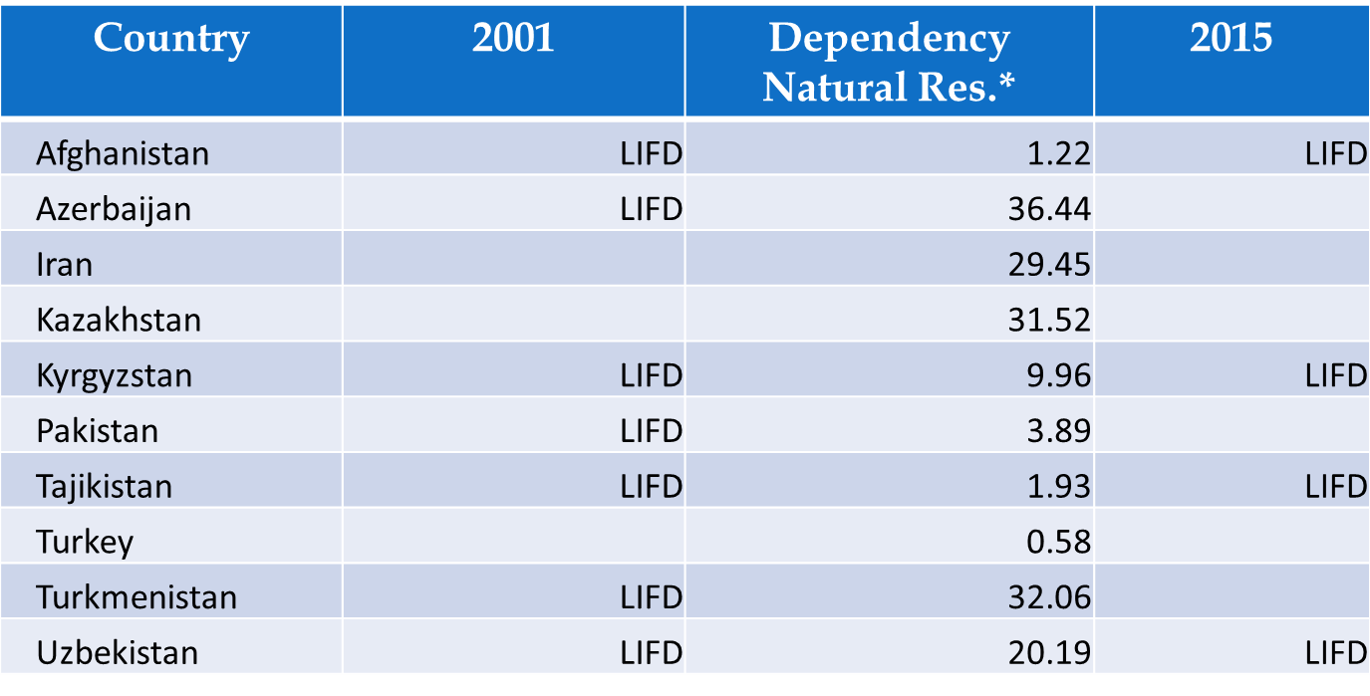
Dependency on Natural Resources
a. “ECO Rules of Procedure”
28. “The Secretary General shall represent the Organization in external relations. He may also designate member(s) of the staff to represent the Organization in international meetings.”
Decrease in oil and commodity prices may change poverty and wealth in ECO countries…
*Total natural resources rents (% of GDP, 2013): Total natural resources rents are the sum of oil rents, natural gas rents, coal rents (hard and soft), mineral rents, and forest rents.

Slide 8
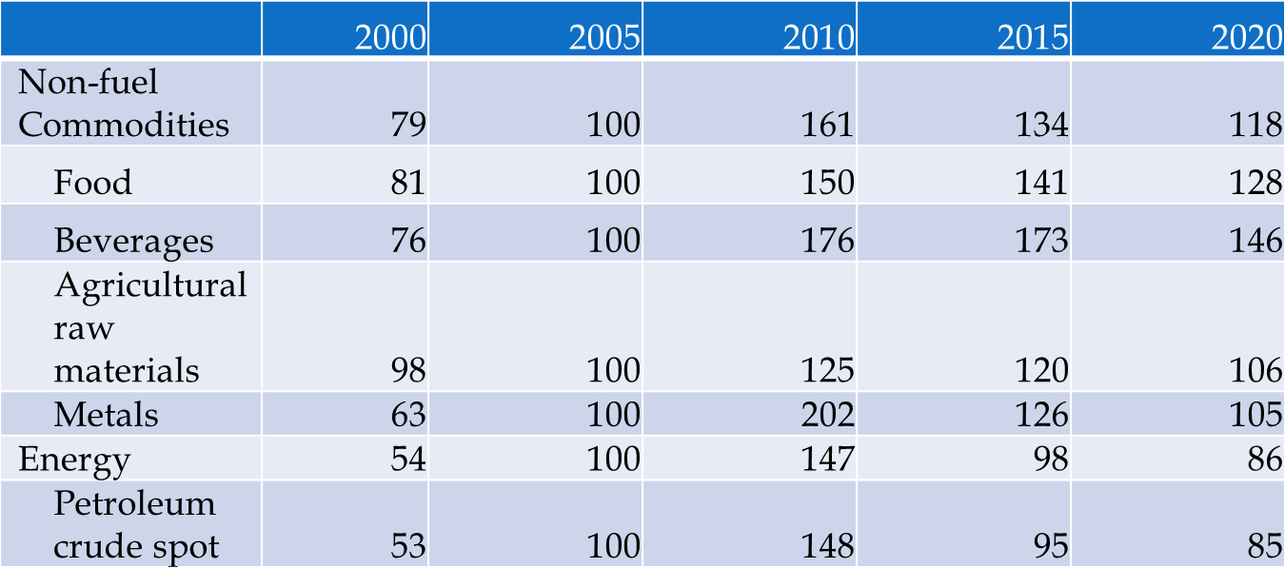
Commodity Prices Index 2005:100
Source: IMF

Slide 9
Some Facts
Price of commodity is decreasing;
Dependency on natural resources is very severe;
Rural population and employment is very high,;
So, for combating poverty and food insecurity, importance of agriculture is increasing in the ECO Region;
Especially any efforts to increase livestock production is valuable.

Slide 10
II. Agriculture Sector in the ECO Region
The Economic Cooperation Organization (ECO):
is dedicated to economic and social development of its Member States;
accords top priority to food security and agricultural development in the Region;
has already launched in 2008 a comprehensive ECO Regional Program for Food Security (ECO-RPFS) (with the technical assistance from FAO), focusing on enhancing agricultural production and trade capabilities in the Member States.

Slide 11
III. ECO Regional Program for Food Security (ECO-RPFS)
Components:
Combating Transboundary Animal Diseases
Integrated Pest Management
Coordinated Research on Wheat Improvement
Inter-and intra Regional Trade Promotion
Support to Agricultural Advisory Services
Development and Maintenance of Pastures
Establishment of Regional Plant Gene bank
Strengthening of Regional Seed Supply
Support to the Regional Centre for Risk Management of Natural Disasters

Slide 12
III. ECO Regional Program for Food Security (Cont’d)
The ECO Regional Center for Risk Management of Natural Disasters (ECO-
RCRM) was established in 2007 in Mashhad, Iran;
The ECO Seed Association (ECOSA) was established in 2009 in Turkey;
The Regional Coordination Centre (RCC) on the implementation of the Regional
Programme for Food Security (RPFS) was established in 2012 in Ankara;
The ECO Veterinary Commission (ECO-VECO) in Tehran is in the establishment process;
ECO Meteorological Calibration Center (ECO-MCC) will be established in
Ankara, Turkey;
The establishment of ECO Centre for Efficient Utilization of Water in Agriculture
in Islamabad is in establishment process;
The ECO Agricultural Biotechnology Network (ECO-ABN) is in establishment process.

Slide 13
IV. Combating Transboundary Animal Diseases
ECO Region offers great potential and presents opportunities for the development of livestock sector
Serious threat to the livestock sector because of Transboundary Animal Diseases (TADs) such as:
Peste des Petits Ruminants (PPR),
foot-and-mouth disease (FMD),
Highly Pathogenic Avian Influenza (HPAI)
and others
Main aims of the ECO-RPFS’ component is to minimize the risk for TADS to spread within and across borders of neighboring countries and thus to improve the health care of the livestock in the ECO Member States

Slide 14
IV. Combating Transboundary Animal Diseases (Cont’d)
Some more facts:
PPR is one of the prominent diseases in the ECO Region
ECO Member States represent 13.6 % of the global small ruminant population (the number of 291.877.153)
Most of the countries in the ECO Region are not in the position to apply drastic control measures, such as massive or targeted slaughter (Because of economical constraints or conflicts with social or religious traditions)
ECO Veterinary Commission (ECO-VECO) in Tehran as a specialized agency of ECO is under establishment process

Slide 15
IV. Combating Transboundary Animal Diseases (Cont’d)
Some more facts:
Some ECO Member States have been affected by PPR such as Afghanistan, Iran, Pakistan and Turkey
Some ECO Member States are at risk such as Azerbaijan, Kazakhstan, Kyrgyz Republic, Tajikistan, Turkmenistan and Uzbekistan
Turkey has formulated national strategies which are under implementation
FAO is currently assisting Afghanistan and Pakistan to formulate and implement national strategic plans

Slide 16
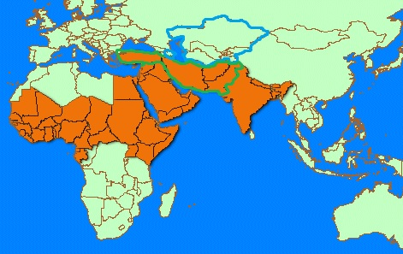
Green Line: Affected ECO Member States Blue Line: at Risk ECO Member States

Slide 17
Prices
Producers Prices Meat live weight
usd/tonne | Cattle |  |  | Sheep
Year | 2014 | 2015 | 2016 | 2014 | 2015 | 2016
Azerbaijan | 2,456 | 1,868 | 1,275 | 2,127 | 2,614 | 1,665
Iran | 4,132 | 3,926 | 3,798 | 4,124 | 3,795 | 4,013
Kazakhstan | 2,227 | 1,961 | 1,369 | 2,523 | 2,219 | 1,399
Kyrgyzstan | 2,845 | 2,440 | 2,211 | 2,847 | 2,415 | 2,085
Turkey | 4,718 | 4,588 | 5,682 | 6,997 | 6,064 | 5,753
Source: FAO.

Slide 18
Number of Sheep and Goats (millions)
 | 2010 | 2015 | 2016
Afghanistan | 20 | 21 | 21
Azerbaijan | 8 | 9 | 9
Iran | 69 | 65 | 62
Kazakhstan | 17 | 18 | 18
Kyrgyzstan | 5 | 6 | 6
Pakistan | 88 | 98 | 100
Tajikistan | 4 | 5 | 5
Turkey | 27 | 41 | 42
Turkmenistan | 16 | 16 | 16
Uzbekistan | 14 | 18 | 19
World | 1986 | 2140 | 2176
ECO Total | 270 | 298 | 298
Percent | 13.6 | 13.9 | 13.7
Source: FAO.

Slide 19
Number of Cattles (millions)
Cattles Stock | 2010 | 2015 | 2016
Afghanistan | 6 | 5 | 5
Azerbaijan | 2 | 2 | 2
Iran | 7 | 5 | 6
Kazakhstan | 6 | 6 | 6
Kyrgyzstan | 1 | 1 | 2
Pakistan | 34 | 41 | 43
Tajikistan | 2 | 2 | 2
Turkey | 11 | 14 | 14
Turkmenistan | 2 | 2 | 2
Uzbekistan | 9 | 11 | 12
World | 1416 | 1452 | 1475
ECO Total | 80 | 91 | 94
Percent | 5.7 | 6.3 | 6.4
Source: FAO.

Slide 20
Number of Chicken (millions)
Chicken Stock | 2010 | 2015 | 2016
Afghanistan | 13 | 12 | 12
Azerbaijan | 21 | 28 | 28
Iran (Islamic Republic of) | 880 | 940 | 1026
Kazakhstan | 31 | 34 | 35
Kyrgyzstan | 4 | 4 | 4
Pakistan | 321 | 470 | 506
Tajikistan | 4 | 5 | 5
Turkey | 235 | 312 | 329
Turkmenistan | 16 | 16 | 17
Uzbekistan | 33 | 56 | 61
World | 20245 | 22112 | 22705
ECO Total | 1558 | 1876 | 2023
Percent | 7.7 | 8.5 | 8.9
Source: FAO.

Slide 21
Trade Figures
 | ECO's exports to (ECO) |  |  | ECO's imports from (ECO) |  |  | ECO's exports to world |  |  | (ECO)'s imports from world
Dollar Million | 2014 | 2016 |  | 2014 | 2016 |  | 2014 | 2016 |  | 2014 | 2016
All products | 34767 | 28863 |  | 36091 | 25344 |  | 396832 | 310571 |  | 433479 | 350841
Live animals | 28 | 21 |  | 84 | 77 |  | 202 | 263 |  | 405 | 797
Meat and edible | 46 | 29 |  | 51 | 25 |  | 1012 | 714 |  | 1057 | 792
Fish | 8 | 4 |  | 5 | 4 |  | 1296 | 1475 |  | 469 | 450
Dairy produce; | 324 | 269 |  | 198 | 171 |  | 1596 | 1444 |  | 1338 | 1070
Products of animal | 19 | 10 |  | 22 | 8 |  | 249 | 173 |  | 84 | 71
Total Animal Products | 425 | 333 |  | 360 | 285 |  | 4354 | 4070 |  | 3354 | 3179
Energy (HS27) | 4641 | 5175 |  | 11625 | 5899 |  | 161843 | 97614 |  | 77156 | 41136
Other | 29701 | 23355 |  | 24106 | 19160 |  | 230634 | 208887 |  | 352969 | 306526
Source: Intracen

Slide 22
Trade Figures
 | Export Share of ECO in ECO |  |  | Export Item's Share of ECO in Total Export |  |  | Import Share of ECO in ECO |  |  | Import Item's Share of ECO in Total import
Dollar Million | 2014 | 2016 |  | 2014 | 2016 |  | 2014 | 2016 |  | 2014 | 2016
All products | 8.8 | 9.3 |  | 100.0 | 100.0 |  | 8.3 | 7.2 |  | 100.0 | 100.0
Live animals | 14.0 | 7.9 |  | 0.1 | 0.1 |  | 20.8 | 9.6 |  | 0.1 | 0.1
Meat and edible | 4.6 | 4.1 |  | 0.1 | 0.1 |  | 4.8 | 3.2 |  | 0.3 | 0.2
Fish | 0.6 | 0.3 |  | 0.0 | 0.0 |  | 1.1 | 1.0 |  | 0.3 | 0.5
Dairy produce; | 20.3 | 18.7 |  | 0.9 | 0.9 |  | 14.8 | 16.0 |  | 0.4 | 0.5
Products of animal | 7.5 | 5.7 |  | 0.1 | 0.0 |  | 25.7 | 10.8 |  | 0.1 | 0.1
Total Animal Products | 9.8 | 8.2 |  | 1.2 | 1.2 |  | 10.7 | 9.0 |  | 1.1 | 1.3
Energy (HS27) | 2.9 | 5.3 |  | 13.3 | 17.9 |  | 15.1 | 14.3 |  | 40.8 | 31.4
Other | 12.9 | 11.2 |  | 85.4 | 80.9 |  | 6.8 | 6.3 |  | 58.1 | 67.3
Source: Intracen

Slide 23
V. Future Activities
The establishment of ECO-VECO needs cooperation and technical assistance from OIE;
For combating transboundary animal diseases in the ECO Region, further support and cooperation from FAO, OIE and Member States is important, including through:
developing projects,
organizing activities,
holding workshops, meetings and conferences
Sub-regional Workshop for ECO Region planned to be organized within the implementation of the Project in coming months will further shed light on the measures to be taken for preventing and reducing the impacts of the PPR
Developing Regional Strategy for Control and Eradication of PPR

Slide 24
Afterword
ECO Region is among the regions with ruminants;
Economies of livestock become more important for the Region because of decrease in oil prices and high population in rural areas;
ECO Secretariat is open to more cooperation and support from international community and Member States for combating transboundary animal diseases.

Slide 25
Thank you! director-AIT@eco.int www.eco.int

