Slide 1







Connecting the national customs system of Uzbekistan with the international
eTIR system
Chief Inspector of the State Customs Committee
of the Republic of Uzbekistan
Khakimov Elyor Ilhomjonovich

Slide 2



Introduction:
Project development in the Republic of Uzbekistan
Regional projects
Getting started with the UNECE
Expected results

Slide 3

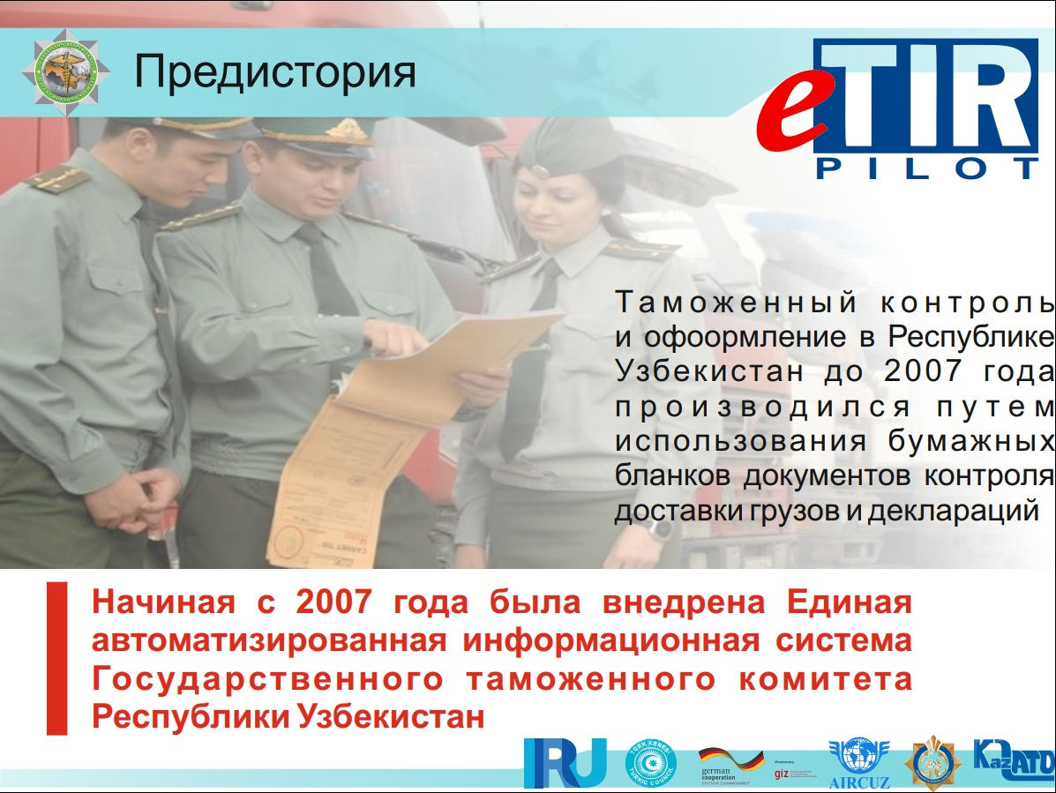
Project development in the Republic of Uzbekistan
Customs control and clearance in the Republic of Uzbekistan until 2007 was carried out by using paper forms of cargo delivery control documents and declarations
In 2007, a Unified automated information system of the customs authorities of the Republic of Uzbekistan was developed

Slide 4
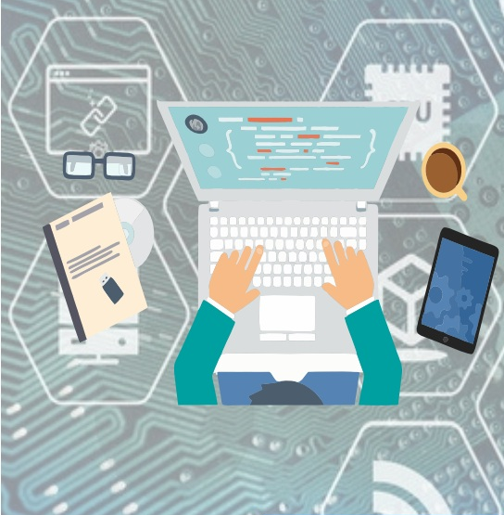
Project development in the Republic of Uzbekistan
At the same time, starting from 2012, the Republic of Uzbekistan, along with other Contracting Countries of the TIR Convention, began to introduce tools for digitalization of the TIR procedure, namely:
1) RTS (real time SafeTIR) - real-time collection, transmission, processing and exchange of data on the termination of operations using TIR Carnets at Customs offices of destination;
2) TIR-EPD-a system of preliminary information on goods under TIR operations;
3) Reconciliation of SafeTIR data – organization of interaction to check the differences between the SafeTIR data and the actual data of the tear-off spines of TIR Carnets after their delivery to the guarantee association;
4) EGIS (Electronic Guarantee Information Service) - used in real time to extract updated information about the TIR Guarantee.

Slide 5
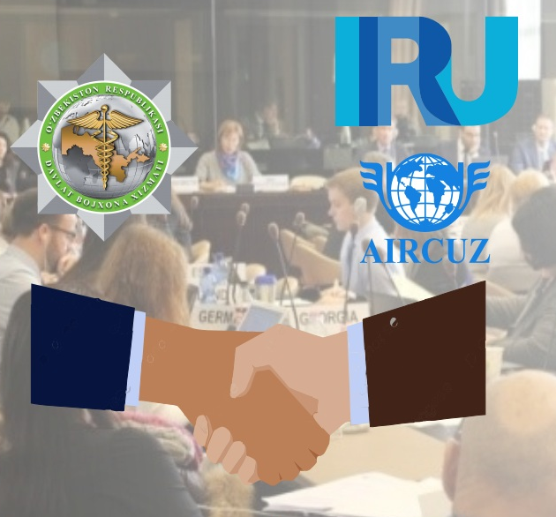
Project development in the Republic of Uzbekistan
The State Customs Committee of Uzbekistan was also interested in pilot projects and signed a number of documents in this direction, namely:
1) 03.12.2018 - "Letter of intent of Uzbekistan to participate
in the eTIR pilot project»;
2 ) 13.03.2019 - «Main principles of the TIR Digitalization project»
3) 23.10.2020 - «Supplement to the TIR Carnet guarantee agreement»

Slide 6
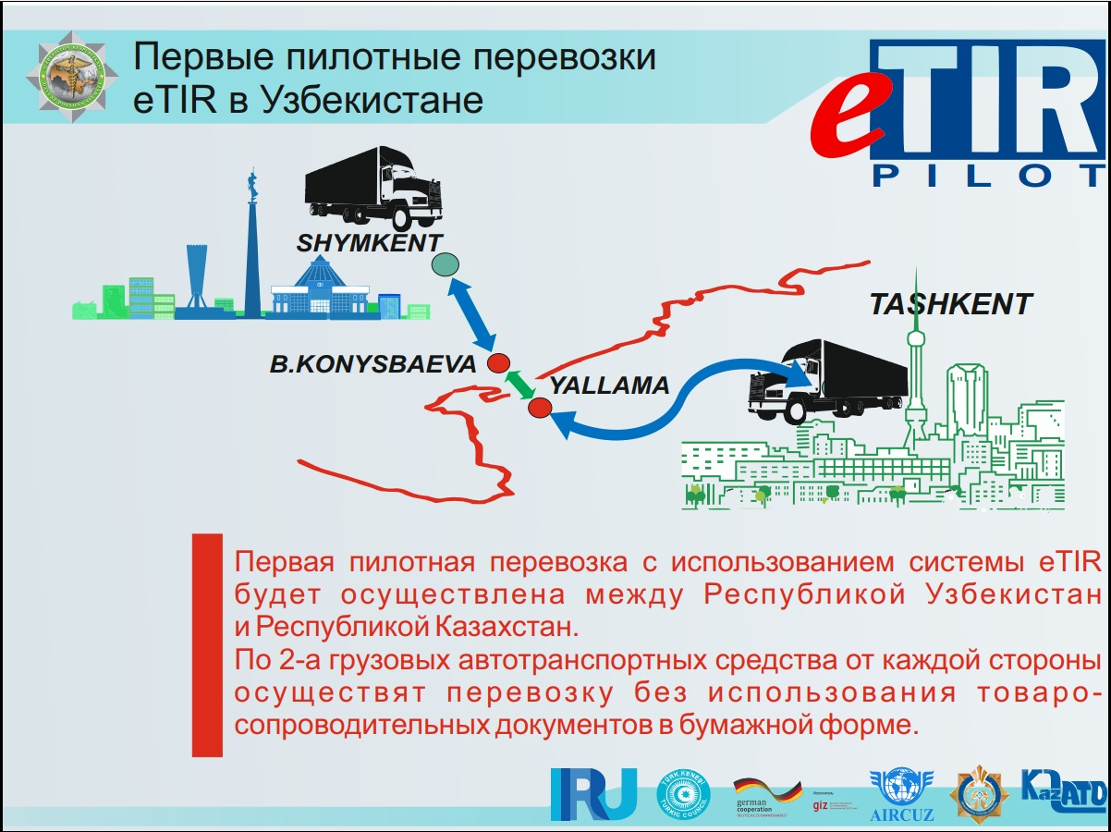
Regional projects
At the same time, on the basis of a five-year Memorandum of Understanding between the UNECE and the IRU, pilot TIR transports were organized using available digital tools

Slide 7
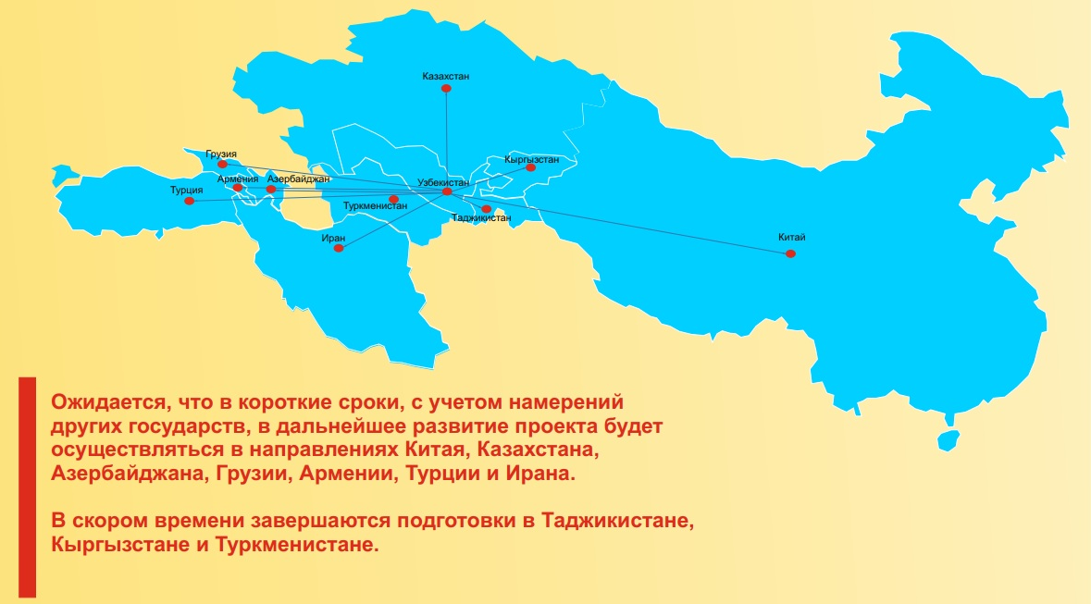
Regional projects
It is planned to continue interaction with other countries within the eTIR International System, on the basis of the existing experience, through connection to the UNECE database, taking into account the entry into force of Annex 11 to the TIR Convention.

Slide 8


Start of work with the UNECE
Currently, the SCC of Uzbekistan is working on joining the International eTIR System together with the support of the UNECE
1. Studying the specifications;
4. Allocation from the UNDA fund to cover the costs of national consultants.
2. Approval of the SCC's work plan for joining the eTIR international system;
3. Participation in Working Groups WP. 30/GE. 1 and WP. 30/GE. 2

Slide 9
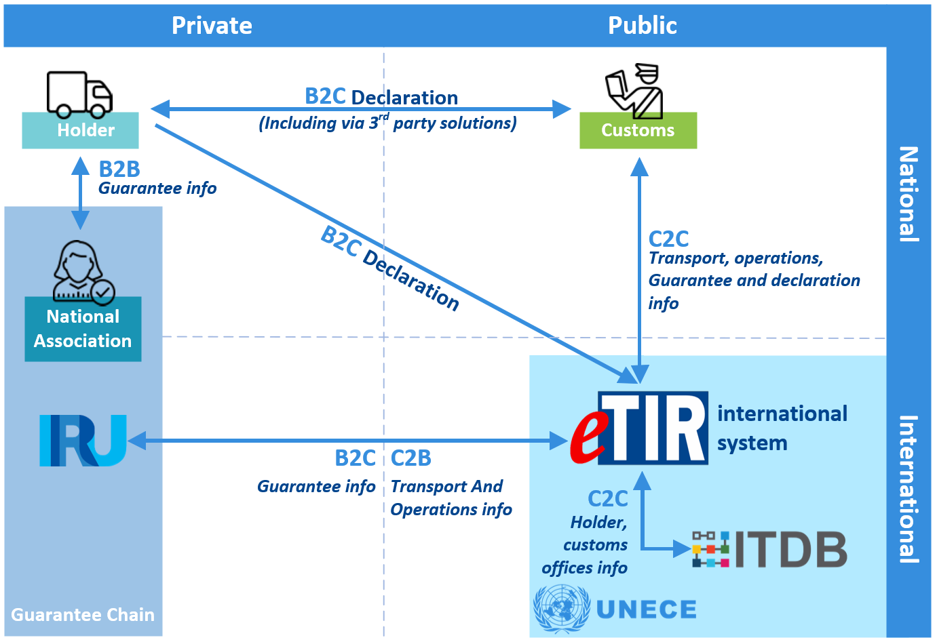
Getting started with the UNECE
It should be noted that the work done earlier in the direction of digitalization should facilitate our work in the future.

Slide 10
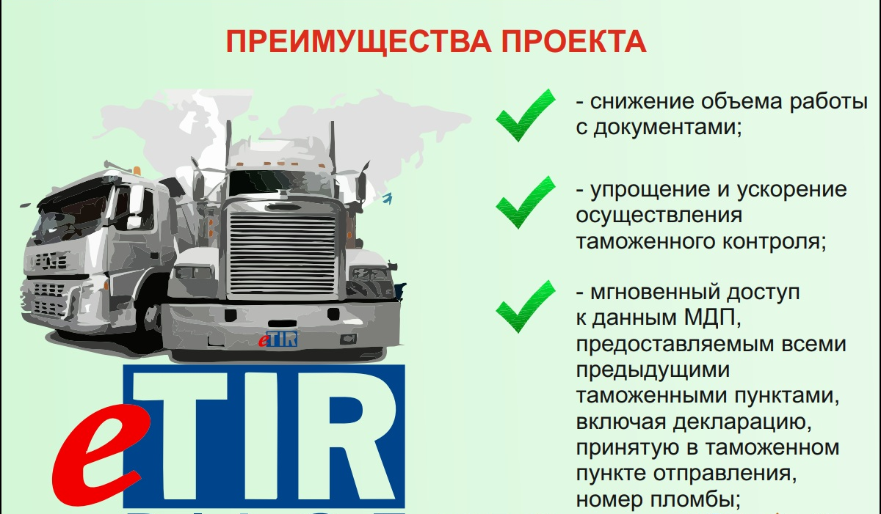
Expected results
Undoubtedly, transition to eTIR transportations in accordance with Annex 11 to the TIR Convention will make a huge contribution to the development of the transport sector, trade facilitation, cost reduction, and other practical aspects.

Slide 11


