Slide 1



International System
Conceptual, Functional and Technical specifications
Andre Sceia
eTIR Interconnections coordinator

Slide 2


Outline
eTIR Major Milestones
ECE intergovernmental Bodies roles about eTIR
Connection to the eTIR IS – Annex 11
eTIR specifications
Architecture overview
eTIR messages

Slide 3
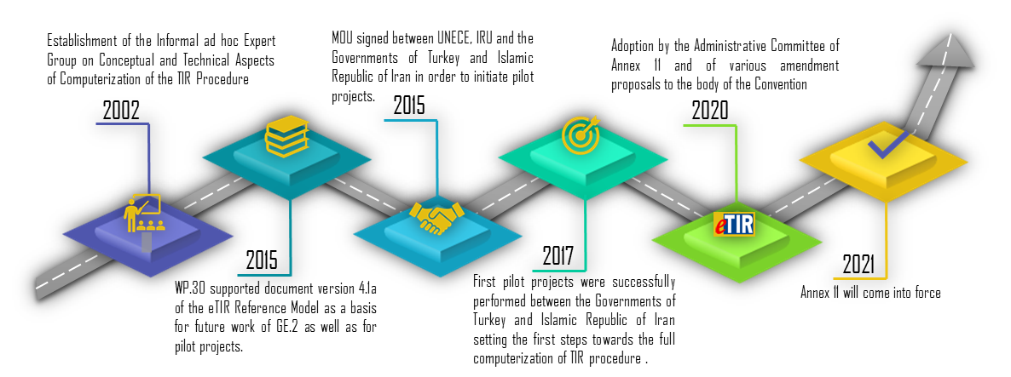
eTIR major milestones

Slide 4
ECE Intergovernmental Bodies roles about eTIR
[Informal Ad hoc] Expert Group on Conceptual and
Technical Aspects of Computerization of the TIR Procedure (GE.1)
Preparation of the eTIR Specifications (Conceptual, Functional and Technical)
Working Party on Customs Questions affecting transport (WP.30)
The Group of Experts on the Legal Aspects of Computerization of the TIR Procedure (GE.2)
Preparation of Annex 11 and related amendments to the TIR Convention
Administrative Committee of TIR Convention (AC.2)
(countries bound by Annex 11)
Preparation of the functional specifications and adopt the technical specifications for the eTIR International System
Technical Implementation Body (TIB)
TIR Executive Board (TIRExB)
Manage ITDB (Holders and Customs offices database)
Adopt Annex 11 as well as the conceptual and functional specifications for the eTIR International System
4

Slide 5
Key concepts in Annex 11
Article 1 : Scope of application
Article 2 : Definitions
Article 3 : Implementation of the eTIR procedure
  1 . Contracting Parties bound by Annex 11 shall connect their customs systems to the eTIR international system in line with the eTIR specifications.
Article 4 : Composition, functions and rules of procedure of the Technical Implementation Body
Article 5 : Adoption and amendment procedures for the eTIR specifications
Article 6 : Submission of advance TIR data and advance amendment data
Article 7 : Authentication of the holder
Article 8 : Mutual recognition of the authentication of the holder
Article 9 : Additional data requirements
Article 10 : Fallback procedure
Article 11 : Hosting of the eTIR international system
Article 12 : Administration of the eTIR international system
Article 13 : Publication of the customs offices capable of handling eTIR
Article 14 : Legal requirements for data submission under Annex 10 of the TIR Convention
Explanatory Notes to Articles 3, paragraph 2; 5, paragraph 3; 6, paragraph 2 and 11, paragraph 3

Slide 6
Conceptual, Functional and Technical specifications
Introduction
  Historical background
  Analysis of the paper TIR system
Concepts
  High lever presentation of the eTIR system, scope, stakeholders, …
  Description of the use cases and high-level data requirements
Functional specifications
  eTIR processes
  eTIR data structure, formats and code lists
  Fallback procedures
Technical specifications
  Architecture
  Technical requirements
  Development and maintenance processes
  Security
  Technical fallbacks

Slide 7
Conceptual, Functional and Technical specifications
Version 4.1
  2014
  Developed by GE.1 and approved by WP.30
  Used for pilot projects and to start the work on Annex 11
Version 4.2
  2017
  Developed by GE.1
  Never used in practice
Version 4.3
  To be finalized in 2021
  Developed by GE.1 and WP.30/GE.1and to be approved by WP:30 and/or AC.2
  Fully aligned with Annex 11
  Used for the interconnections of customs administrations to the eTIR international system
Version 4.4
  Work starting in 2022
  To be developed by the TIB
  Will further improve the eTIR specifications and the eTIR international system

Slide 8
The eTIR international system
Role
  Customs management of data on guarantees
  Customs to Customs exchange of eTIR data (transport and operations)
Developed and maintained by ECE
Hosted at UNOG
Interconnected with
  customs administrations (centrally)
  the guarantee chain (IRU)
  transport companies
  ITDB

Slide 9
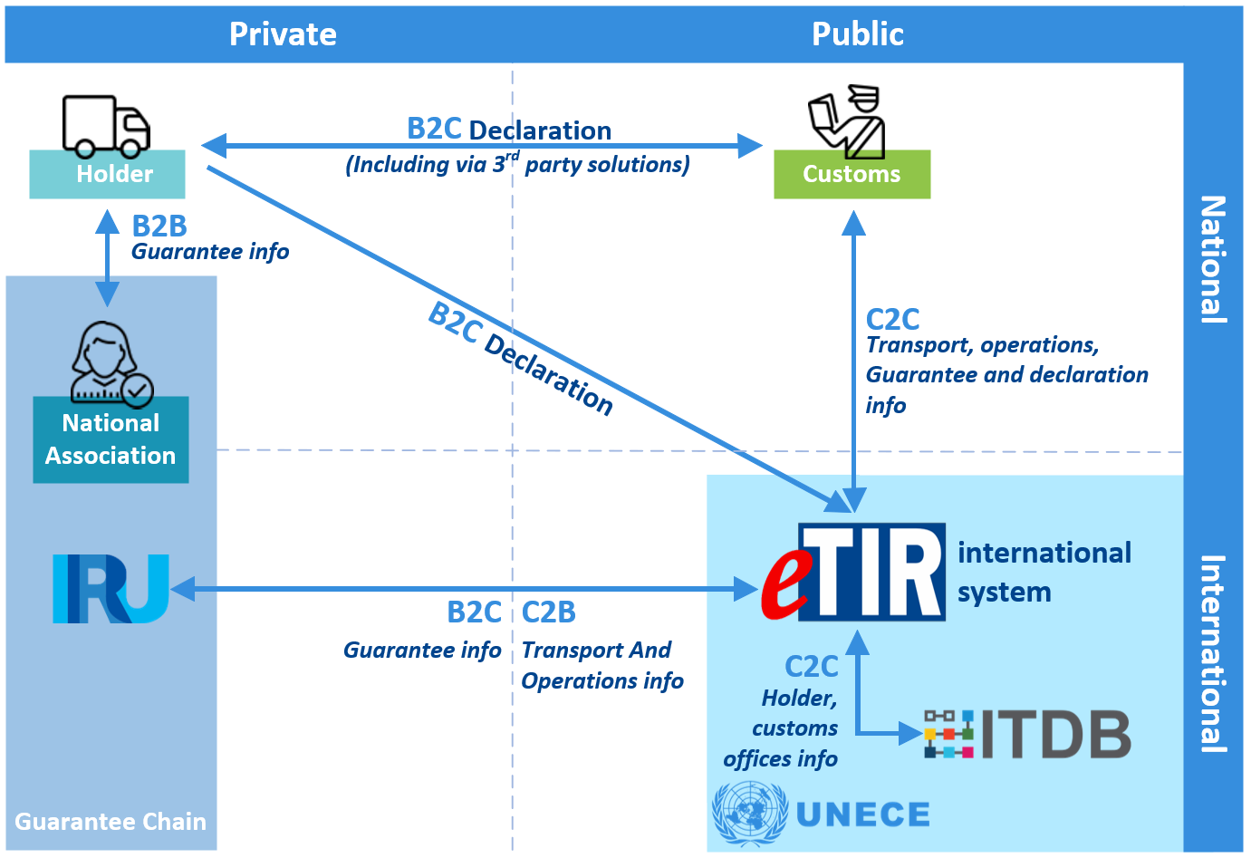
Architecture overview

Slide 10
eTIR messages
Standard use cases
Special use cases
Guarantee issuance
Guarantee cancellation
Submission of advance TIR data
Cancel advance data
Acceptance of the declaration
Acceptance of the amendments to the declaration
Start a TIR operation
Amending the declaration data
Terminate a TIR operation
Refusal to start a TIR operation
Discharge a TIR operation
Query the guarantee
Checks/validations in ITDB

Slide 11
eTIR messages
External messages (B2C)
Internal messages (C2C)
E1
E2
Record guarantee
I1
I2
Accept guarantee
E3
E4
Cancel guarantee
I3
I4
Get holder info
E5
E6
Query guarantee
I5
I6
Query guarantee
E7
E8
Notify guarantee chain
I7
I8
Record declaration data
E9
E10
Advance TIR data
I9
I10
Start TIR operation
E11
E12
Advance amendment data
I11
I12
Terminate TIR operation
E13
E14
Cancel advance data
I13
I14
Discharge TIR operation
I15
I16
Notify customs
I17
I18
Refusal to start TIR operation
I19
I20
Check customs office

Slide 12
eTIR messages
Guarantee issuance
E1
Register guarantee
E2
Notes:
After a guarantee has been issued to a holder, the guarantee chain registers the guarantee message in the eTIR international system by sending the E1 message. The eTIR international system acknowledges receipt with the E2 message.

Slide 13
eTIR messages
Submission of advance TIR data
E9
Advance TIR data
E10
Notes:
The holder transmits advance TIR data to the customs authorities of the country of departure by means of the E9 message. Customs authorities acknowledges receipt with the E10 message.
Alternatively, the holder can make use of 3rd party solution approved by the customs administration of the country of departure, sent the E9 message via the eTIR international system or via a declaration mechanism provided by the Customs authorities of his/her country of residence (if available).

Slide 14

eTIR messages
Acceptance of the declaration
Accept guarantee
I1
I2
Record declaration data
I7
I8
Notify customs
I15
I16
(all countries along the itinerary)
E7
Notify guarantee chain
E8
Notes:
Upon acceptance of the declaration (in the basis of the advance TIR data and the controls performed), customs authorities of the country of departure start by accepting the guarantee by means of the I1 message. The eTIR international system acknowledges receipt with the I2 message.
As a second step, they record the declaration data in the eTIR international system by means of the I7 message. Once the eTIR international system will have notified all countries along the itinerary by means of the I15 message (each country responding by means of the I16 message, which includes a national reference for the transport), it will respond to the customs authorities of the country of departure with the I8 message, which will include all national references of countries along the itinerary).
The guarantee chain is also notified of the acceptance of the declaration by means of the E7 message and will acknowledge receipt with message E8.

Slide 15
eTIR messages
Start a TIR operation
Start TIR operation
I9
I10
E7
Notify guarantee chain
E8
Notes:
Upon satisfactory controls (documentary or physical), customs authorities start the TIR operation and send an I9 message to the eTIR international system. The eTIR international system acknowledges receipt with the I10 message. In the country of departure and whenever sealing devices are changed, the I9 message contains information on the seals.
The guarantee chain is notified of the start of the TIR operation by means of the E7 message and will acknowledge receipt with message E8.

Slide 16
eTIR messages
Terminate a TIR operation
Terminate TIR operation
I11
I12
E7
Notify guarantee chain
E8
Notes:
Upon satisfactory controls (documentary or physical), customs authorities terminate the TIR operation and send an I11 message to the eTIR international system. . The eTIR international system acknowledges receipt with the I12 message.
The guarantee chain is notified of the start of the TIR operation by means of the E7 message and will acknowledge receipt with message E8.

Slide 17
eTIR messages
Discharge a TIR operation
Discharge TIR operation
I13
I14
E7
Notify guarantee chain
E8
Notes:
Upon satisfactory discharge of the TIR operation, customs authorities send an I13 message to the eTIR international system. . The eTIR international system acknowledges receipt with the I14 message.
The guarantee chain is notified of the start of the TIR operation by means of the E7 message and will acknowledge receipt with message E8.

Slide 18
eTIR messages
Query the guarantee
Query guarantee
I5
I6
E5
Query guarantee
E6
Notes:
At any time, customs authorities and the guarantee chain can query the eTIR international system to obtain information about guarantees they are involved in or that they have issued.

Slide 19
eTIR messages
Checks/validations in ITDB
Get holder info
I3
I4
Check customs office
I19
I20
Notes:
The eTIR international system queries the ITDB to obtain the latest data related to TIR Carnet Holder and customs offices approved for eTIR.

Slide 20
eTIR messages
Guarantee cancellation
E3
Cancel guarantee
E4
Notes:
If a guarantee, which has been issued to a holder and registered in the eTIR international system, is canceled the guarantee chain cancels the guarantee in the eTIR international system by sending the E3 message. The eTIR international system acknowledges receipt with the E4 message. If the TIR transport has started the effective cancellation of the guarantee will only take place at the termination of the TIR operation currently taking place.

Slide 21
eTIR messages
Cancellation of advance data
E13
Cancel advance data
E14
Notes:
In case of an error or a logistic change, the holder can cancel the advance TIR data or the advance amendment data by sending an E13 message to the customs authorities of the country of departure The customs authorities acknowledges receipt with the E14 message.
Alternatively, the holder can make use of 3rd party solution approved by the customs administration of the country of departure, sent the E13 message via the eTIR international system or via a declaration mechanism provided by the Customs authorities of his/her country of residence (if available).

Slide 22
eTIR messages
Request changes to the declaration data
(e.g. change of itinerary, additional loading, ..)
E11
E12
Advance amendment data
Notes:
The holder can request amendment to the declaration data to the customs authorities by means of the E11 message. Customs authorities acknowledge receipt with the E12 message.
Alternatively, the holder can make use of 3rd party solution approved by the customs administration, sent the E11 message via the eTIR international system or via a declaration mechanism provided by the Customs authorities of his/her country of residence (if available).

Slide 23
eTIR messages
Acceptance of the amendments to the declaration
Record declaration data
I7
I8
Notify customs
I15
I16
(all countries along the itinerary)
E7
Notify guarantee chain
E8
Notes:
Upon acceptance of the revised declaration (in the basis of the advance amendment data and the controls performed), customs authorities of the country of departure record the amended declaration data in the eTIR international system by means of the I7 message. Once the eTIR international system will have notified all countries along the itinerary by means of the I15 message (each country responding by means of the I16 message, which includes a national reference for the transport), it will respond to the customs authorities of the country of departure with the I8 message, which will include all national references of countries along the itinerary).
The guarantee chain is also notified of the acceptance of the declaration by means of the E7 message and will acknowledge receipt with message E8.

Slide 24
eTIR messages
Refusal to start a TIR operation
Refusal to start a TIR operation
I17
I18
E7
Notify guarantee chain
E8
Notes:
In case a TIR transport has to be terminated because a country refuses to start a TIR operation, customs authorities of the country refusing to start the TIR operation send to the eTIR international system an I17 message. The eTIR international system will acknowledge receipt by mean of the I18 message.
The guarantee chain is also notified of the refusal to start by means of the E7 message and will acknowledge receipt with message E8.

Slide 25

Thank you!
More information on eTIR here:

