Slide 1

Digitalization & e-TIR Status in I.R.IRAN
14 April 2021 – Teran
Notes:
the bilateral trade between India and the entire Eurasian Economic Union (the EEU, consisting of Russia, Armenia, Belarus, Kazakhstan, and Kyrgyzstan) was merely $8.4 billion in 2015-2016.

Slide 2

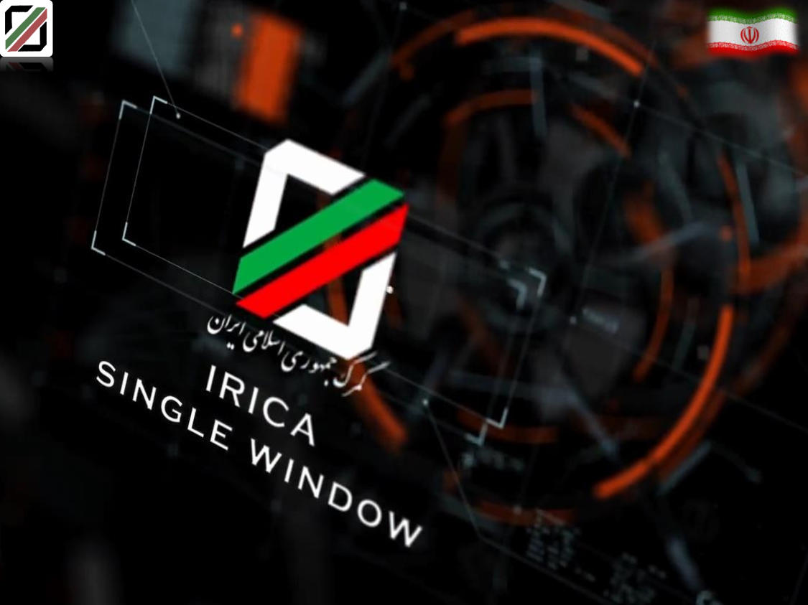
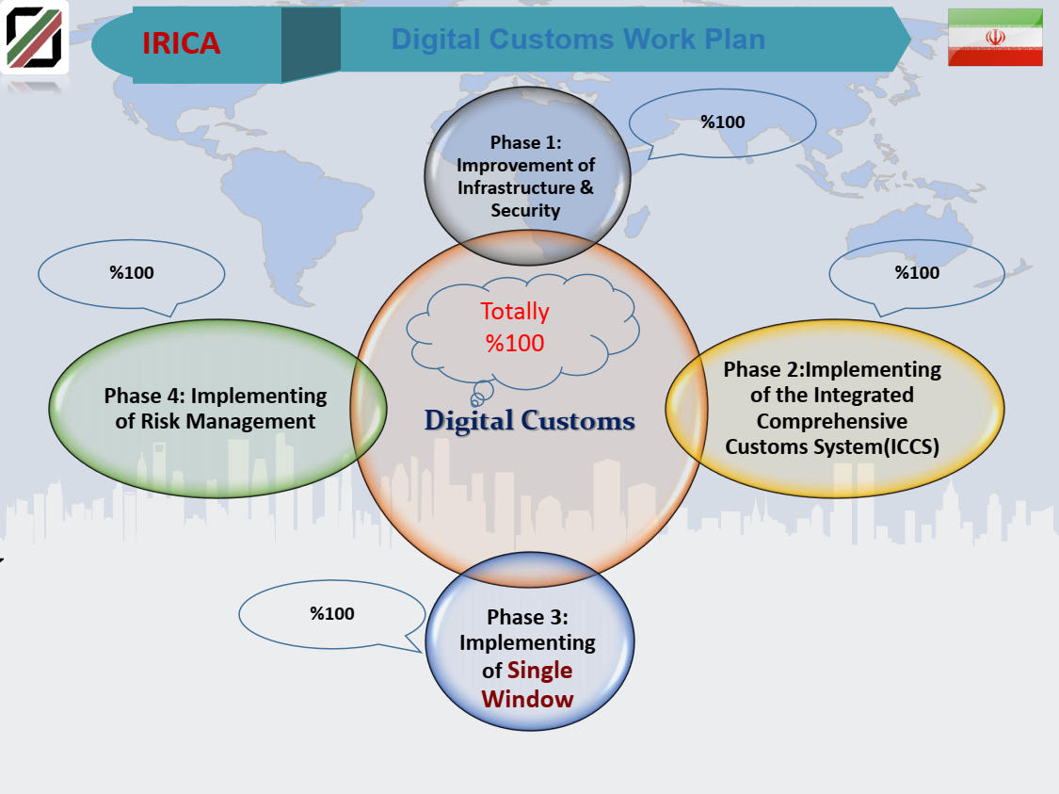


Slide 3
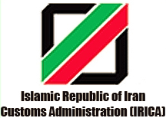
Customs procedures before digitalization in 1997
Paper based system with 1,500,000 declarations except TIR carnet in 140 customs offices.
The high risk of forging permits issued by other organizations.
since 1997 IRICA started the implementation of ASYCUDA system.
Due to some limitations in ASYCUDA, IRICA decided to implement its own national system (Integrated Customs System) since 2013
by implementing ICS, data entry via pre-declaration is possible at any time.
Notes:
the bilateral trade between India and the entire Eurasian Economic Union (the EEU, consisting of Russia, Armenia, Belarus, Kazakhstan, and Kyrgyzstan) was merely $8.4 billion in 2015-2016.

Slide 4
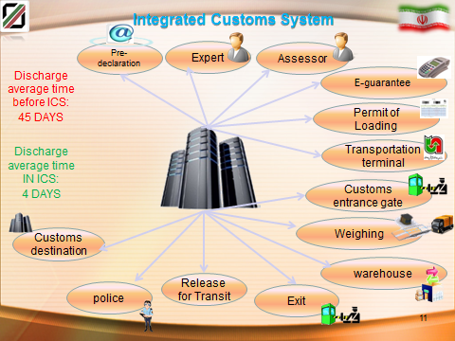
The benefits of ICS
By running a single window & fully paperless system hah led to reduction of charges, forging etc.
In transit the electronic data exchange between departure and destination has expedited the discharge process.
Notes:
the bilateral trade between India and the entire Eurasian Economic Union (the EEU, consisting of Russia, Armenia, Belarus, Kazakhstan, and Kyrgyzstan) was merely $8.4 billion in 2015-2016.

Slide 5
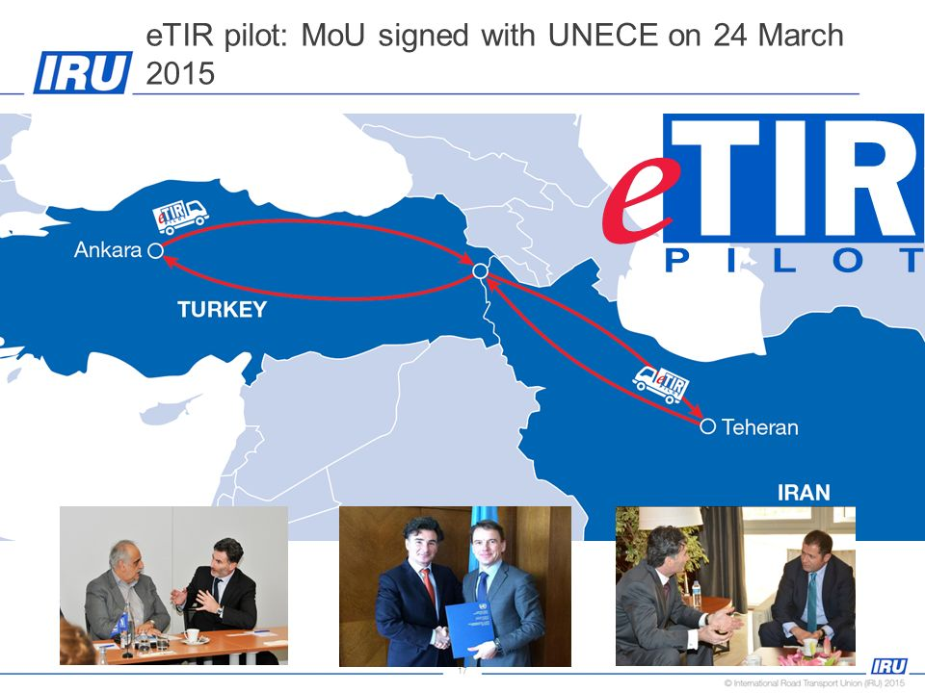
e-TIR Project
Since only the TIR system was not paperless, IRICA initiated e-TIR project with Turkey in 2014
The eTIR Project aimed at bringing the TIR procedure to a computerized environment, further enhancing the security and efficiency of the TIR system
The first phase was successfully implemented in 2015.
Currently, implementing full digital in TIR with Turkey is underway
Notes:
the bilateral trade between India and the entire Eurasian Economic Union (the EEU, consisting of Russia, Armenia, Belarus, Kazakhstan, and Kyrgyzstan) was merely $8.4 billion in 2015-2016.

Slide 6

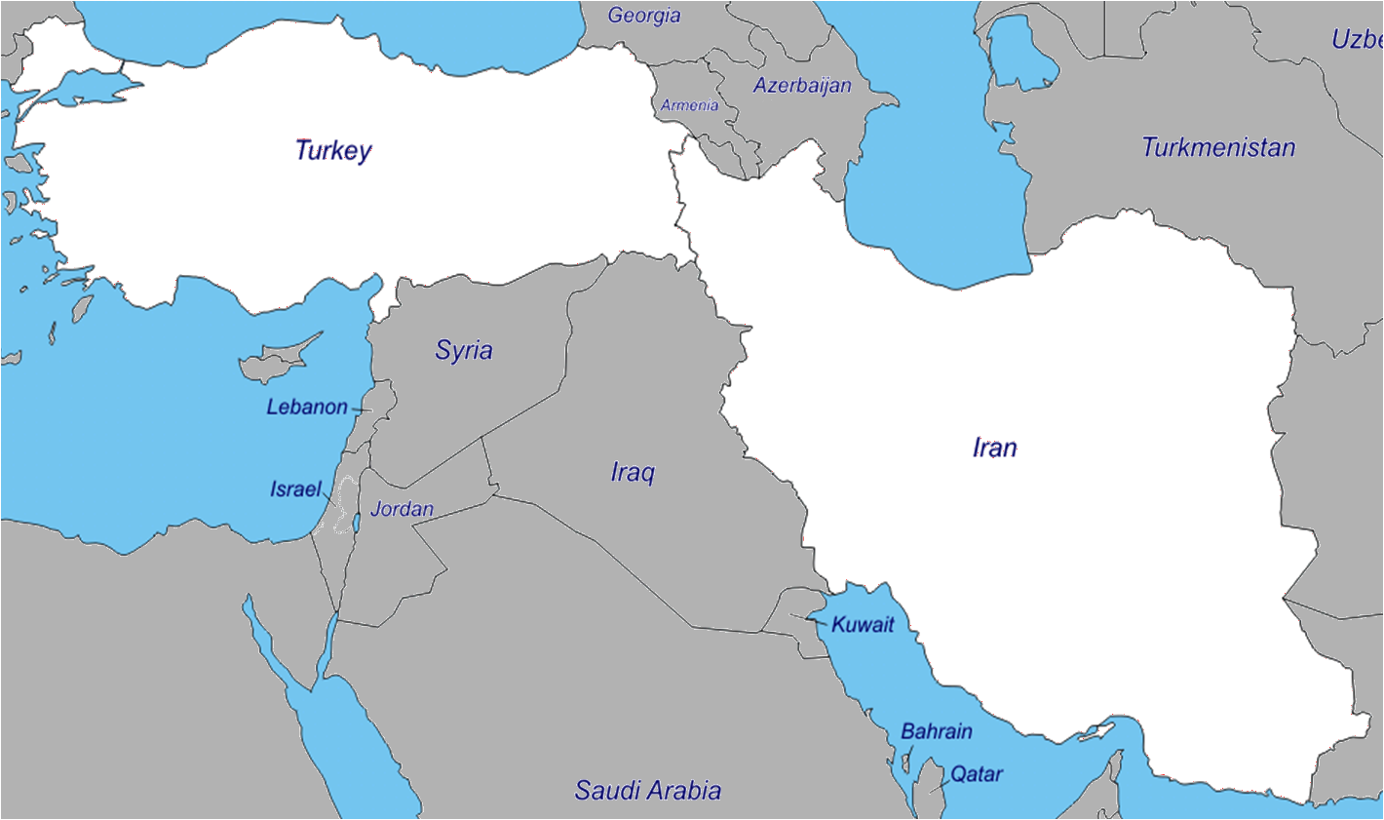




eTIR pilot projects Iran-Turkey-UNECE-IRU
Gebse,
Dilovasi
Istanbul, Erenköy
Derince
Gürbulak
Izmir
Bazargan
Sahlan
Ege Serbest
Bolge
Gaziantep
Tabriz
Adana
Zanjan
Mersin
West Tehran
Tehran
PILOT PROJECT FRAME
19 Customs Offices
6 Holders
I.P.E.F.Z
Isfahan
PILOT PROJECT FRAME
19 Customs Offices
6 Holders
100+ eGuarantees issued

Slide 7
Feedback by pilot project stakeholders
Faster, safer
Less bureaucracy
Less workload
Less paper management
Higher accuracy
More effective risk analysis
Online monitoring of the transport
Cheaper procedure, no TIR Carnets stock
Allowed enhancements (electronic payment project)
Overall score
given to the pilot project*
8.25/10

Slide 8
2nd successful eTIR project
Iran-Azerbaijan
AZE
IRN

Slide 9
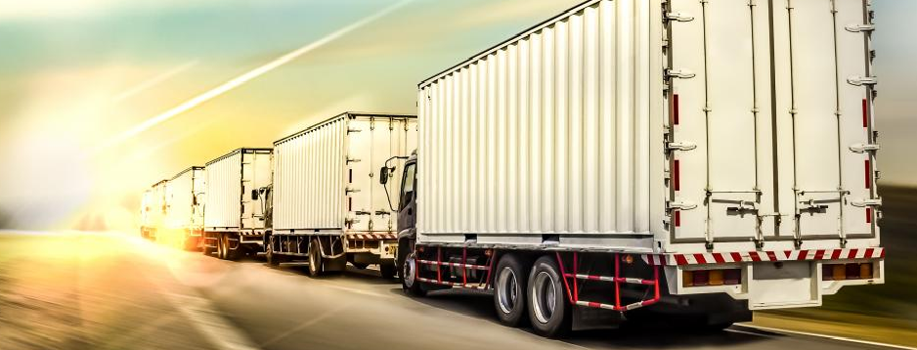
Digitalisation and regional connectivity
The first phase of digital project between Iran and Azerbaijan initiated in 18th June 2019 and both countries intend to expand TIR throughout the International North-South Corridor.
Notes:
the bilateral trade between India and the entire Eurasian Economic Union (the EEU, consisting of Russia, Armenia, Belarus, Kazakhstan, and Kyrgyzstan) was merely $8.4 billion in 2015-2016.

Slide 10
e-TIR between Iran-Azerbaijan-Georgia
Due to success of the e-TIR project between IRAN and Azerbaijan also Customs authorities of Iran, Azerbaijan and Georgia agreed to implement e- TIR corridor between each other. The first meeting held in the end of October 2020 in Iran-Ardebil but unfortunately due to Covid-19 pandemic crises the project is not kicked off.
GEO
TUR
AZE
IRN

Slide 11
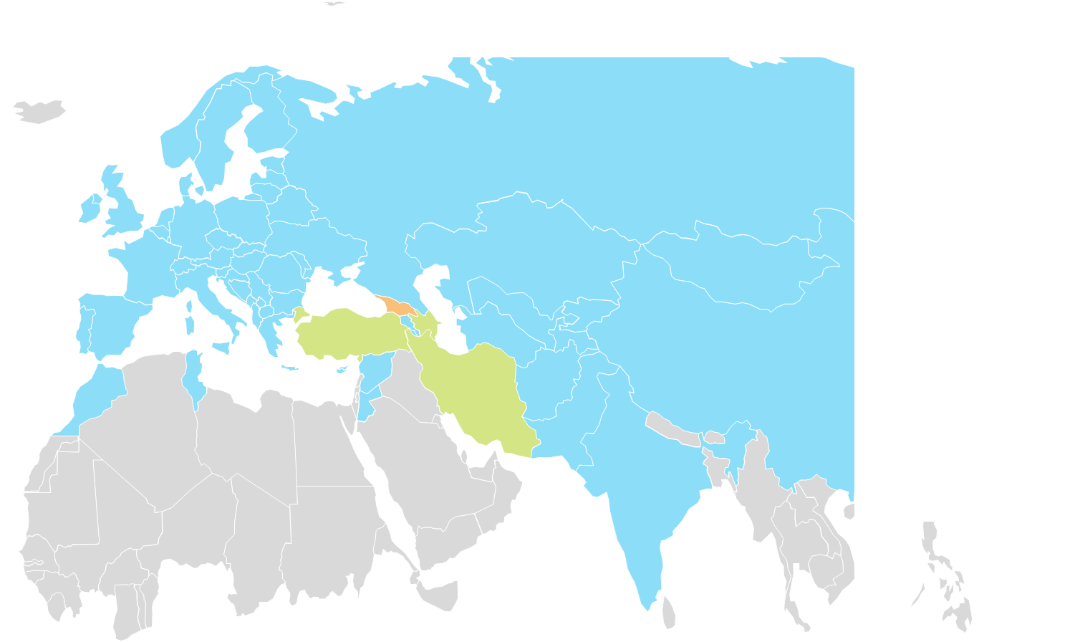
e-TIR in the ECO region (Chabahar port-Southern Iran)
Iran – Afghanistan
Chabahar - KTAI corridor
Chabahar- INSTC
Chabahar

Slide 12
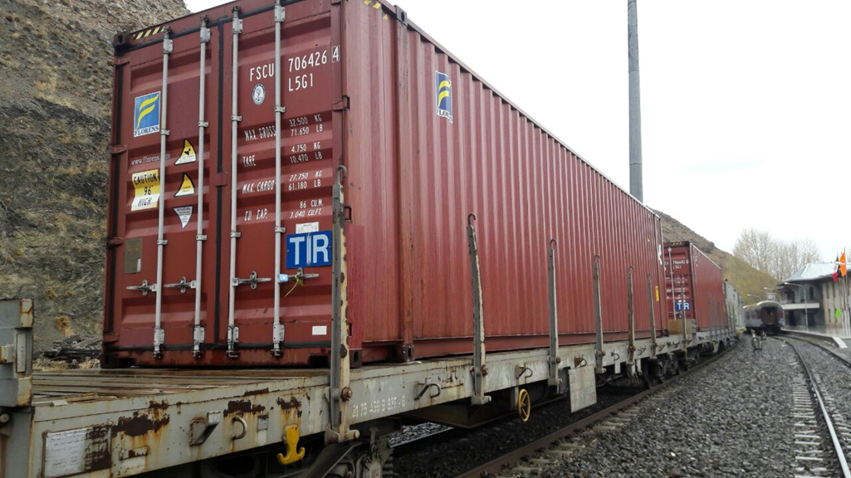
Experience of Iran in Intermodal TIR (Slovenia-Italy-Turkey-Iran) -2017
Notes:
the bilateral trade between India and the entire Eurasian Economic Union (the EEU, consisting of Russia, Armenia, Belarus, Kazakhstan, and Kyrgyzstan) was merely $8.4 billion in 2015-2016.

Slide 13
Implementation of Annex11 – I.R.Iran
Implementation of first pilot projects with MOU (based on TOR)
Establishment of legal base for facilitation for future projects could be base on provision of Annex 11 and e-TIR international system.
Interconnection with e-TIR international system;
I.R.Iran held meetings with UNECE and modality and technical overview of e-TIR discussed and currently It is undergoing.
By fulfilment of criteria and necessary measures of e-TIR international system, ready for expansion of e-TIR between ECO member states
Notes:
the bilateral trade between India and the entire Eurasian Economic Union (the EEU, consisting of Russia, Armenia, Belarus, Kazakhstan, and Kyrgyzstan) was merely $8.4 billion in 2015-2016.

Slide 14
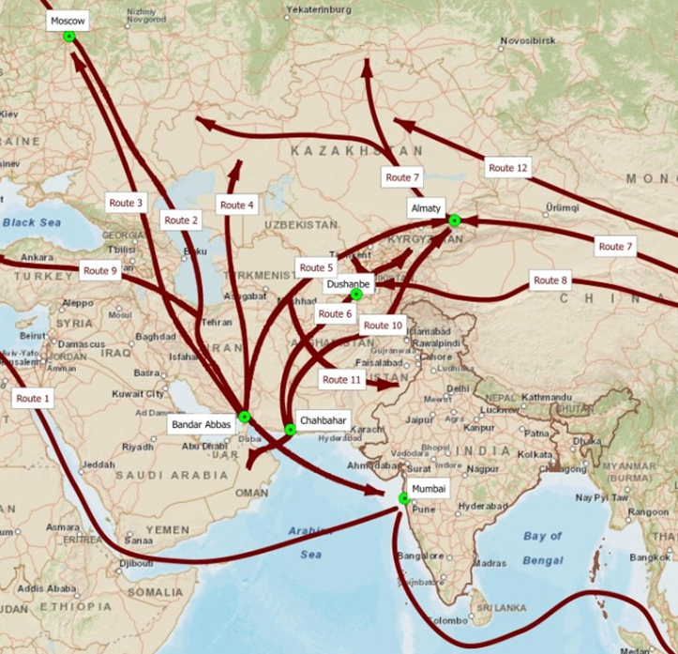
Iran`s vision on transit and transport in the region
Iran is cooperating with all its neighbouring countries to expand Transit system and put all the corridors and transport agreements under digital and intermodal including;
Ancient Silk Road
ECO corridors
INSTC Corridor
Chabahar Agreement
Ashgabat Agreement
Turkey-Iran-Qatar corridor
Iran-Azerbaijan- (KTAI) digital TIR
Iran-Pakistan-Turkey digital TIR
Notes:
the bilateral trade between India and the entire Eurasian Economic Union (the EEU, consisting of Russia, Armenia, Belarus, Kazakhstan, and Kyrgyzstan) was merely $8.4 billion in 2015-2016.

Slide 15
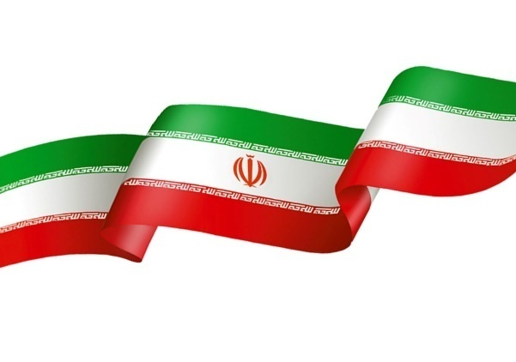
Thank you for your attention

