Slide 1
international
system
Promote implementation of Annex 11 of TIR
Convention on eTIR in the ECO region and beyond
Interconnection of National Customs Systems
with the eTIR international system
eTIR interconnection projects
Sébastien GALTIER
eTIR Information Technology expert
April 14th, 2021
Notes:
Good morning distinguished delegates
I am Sébastien Galtier, IT expert and I coordinate all IT efforts in the TIR secretariat inluding the development of the eTIR international system and the International TIR Data Bank
I am going to present you the eTIR interconnection project

Slide 2
Outline
What are “interconnection projects”?
Proposed approach
Focus on the “gap analysis”
Documentation available
Status of the interconnection projects

Slide 3
I. What are “interconnection projects”?
Objective of an interconnection project (for Customs)
To connect the national customs system with the eTIR international system
Annex 11 of the TIR Convention (Article 11)
“ECE shall assist countries in connecting their customs systems to the eTIR international system, including by means of conformance tests to ensure their proper functioning prior to the operational connection”
Notes:
Objective
Each contracting party bound by Annex 11 has to connect its nationals customs systems with the eTIR international system
UNECE shall assist them in doing so
As you will see later with the stages of a typical interconnect project, this assistance from ECE is performed throughout the entire project

Slide 4
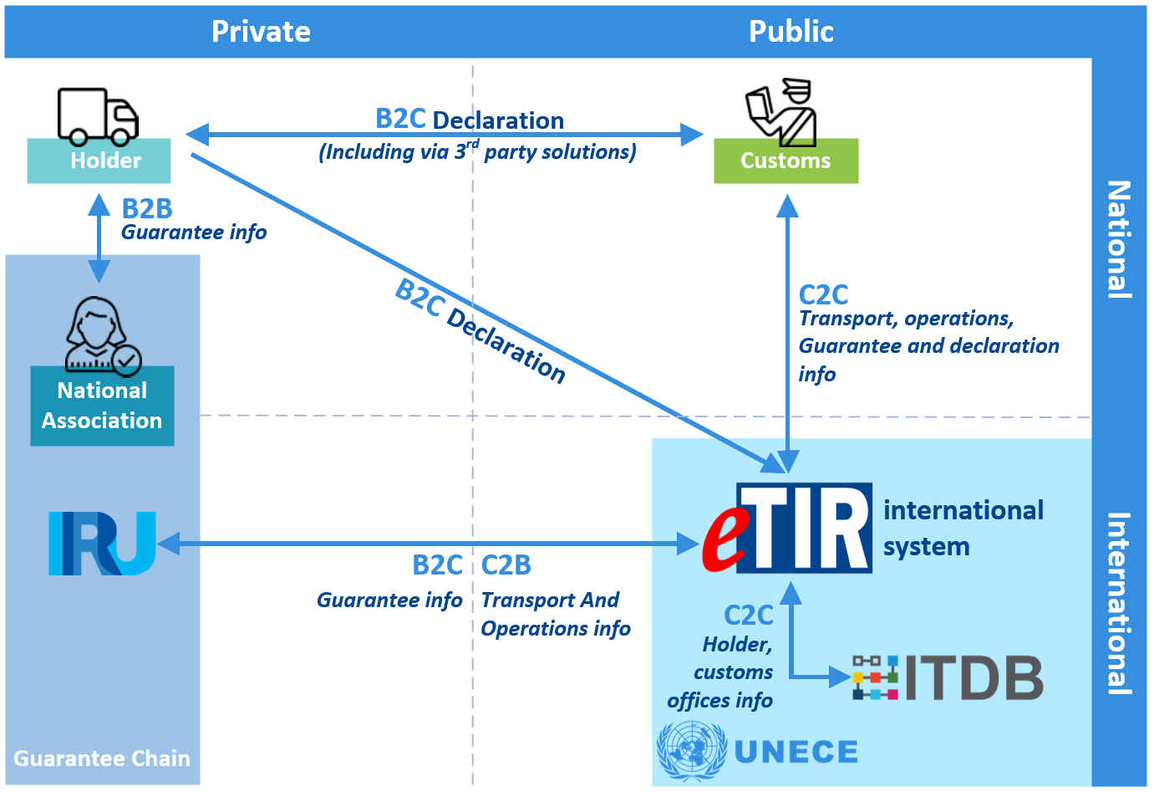
I. Architecture overview
Notes:
This diagram presents the various actors that intervene in the eTIR procedure. It is divided in four quadrants: on the left side the private sector and on the right side the public sector. On the upper row the national level and on the bottom row the international level. In the upper left corner we find the TIR Carnet holder and its national association. In the upper right corner the customs authorities of the contracting parties to the TIR convention. In the lower left corner the international organization authorized by the AC.2 to operate the TIR system (here, the IRU). In the lower right corner the Economic Commission for Europe with its two information systems: the eTIR international system which is the central piece of data exchange of the eTIR procedure and the International TIR Data Bank which is manages the list of authorized TIR Carnet holders and the list of approved customs offices available for TIR operations.

Slide 5
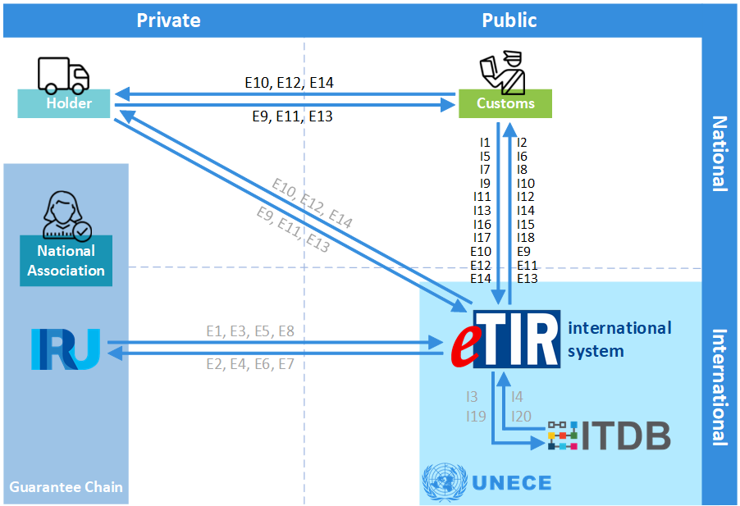
I. Architecture overview - Messages
Notes:
Now you can see the same architecture of the eTIR procedure but this time with all messages exchanged. We have also highlighted in black the messages that are exchanged between customs authorities and other actors like the holder and the eTIR international system

Slide 6
II. Proposed approach – Stages
Time

Slide 7
II. Stage: Project Initiation Stage
Objectives / Activities
Customs team: nominate the project manager and the team members
Agree with ECE on the project management methodology
Agree with ECE on collaboration arrangements
Elaborate a first version of the project plan

Slide 8
II. Stage: Design Stage
Objectives / Activities
Acquire all knowledge needed on the eTIR procedure and the eTIR international system from the eTIR specifications
Perform a gap analysis between the processes and data model detailed in the eTIR specifications and the processes and data model of the national customs system
List all changes to be applied to the national customs system to adapt to the eTIR procedure
Produce the documentation needed for the implementation stage
Update the project plan accordingly

Slide 9
II. Stage: Implementation Stage
Objectives / Activities
Implement and test the messages needed to communicate with the eTIR international system
Interconnect with the eTIR international system
Implement and test the changes specified and documented in the previous phase in the national customs systems so that it can properly manage the eTIR procedure
(All these objectives / activities are performed in close collaboration with ECE)

Slide 10
II. Stage: Conformance Tests Stage
Objectives / Activities
In collaboration with ECE, perform additional tests by simulating all possible TIR transports and cases foreseen in the TIR Convention which can happen in the context of the eTIR procedure
Verify the conformance of the newly produced version of the national customs systems with the eTIR procedure and the eTIR specifications
Document the updated version of the national customs system
Train the customs officers on the updated national customs system
Deploy the updated national customs system “in Production”

Slide 11
II. Last two stages
Continuous Progress Review Stage - Objectives / Activities
Facilitate information exchange and collaboration between the Customs team and ECE
Quickly investigate and correct any issues arising during the project
Project Closure Stage - Objectives / Activities
Proper hand over from the Project team to the Operations team (in Customs)
Usual project closure activities and best practices
Formally close the project and issue a final report

Slide 12
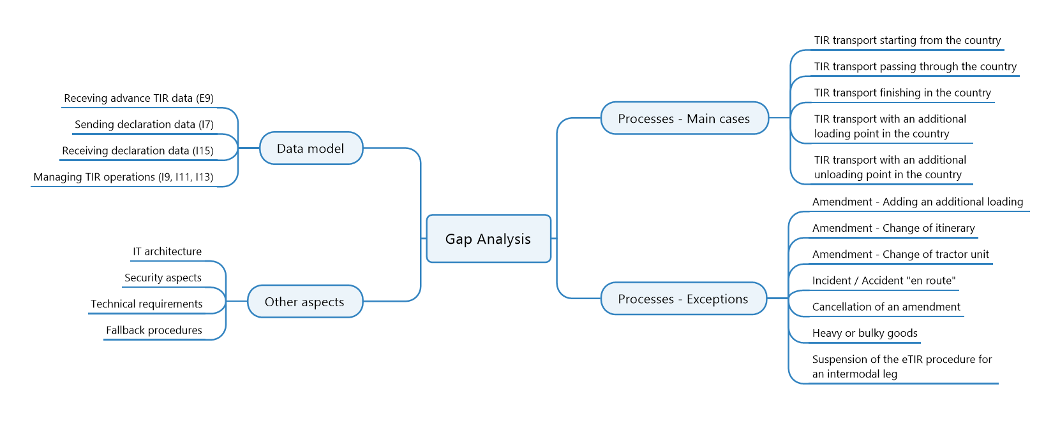
III. Focus on the gap analysis

Slide 13
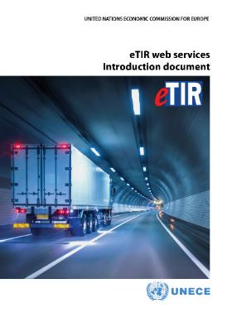
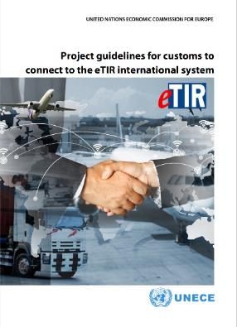
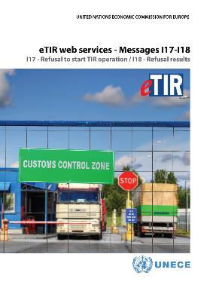
IV. Documentation available
On the project
The Project Guidelines document detailing our proposal on all aspects of the interconnection project
On the eTIR specifications
v4.2: the Introduction, Concepts and Functional specifications documents are available on the eTIR web site and on the eTIR documentation portal
v4.3 is being finalized at the WP.30/GE.1 (May 25th-28th)
On the Technical Guides
The Introduction document and the technical guides on messages I1/I2, I5/I6, I7/I8, I9/I10, I11/I12, I13/I14 and I17/I18
The other guides are being finalized and will be published on the eTIR documentation portal

Slide 14
V. Status of the interconnection projects
On 7 April 2020, ECE invited the contracting parties to connect to eTIR
17 countries expressed their interest so far:
ECE and the European Commission (27 countries) are working on a Proof of Concept for interconnectioning NCTS with the eTIR international system
Following a request from the Russian Federation, ECE has already invited the EEC to initiate a Proof of Concept with the EEC and its five member States
Armenia
Azerbaijan
Georgia
India
Iran (Islamic Republic of)
Israel
Lebanon
Montenegro Morocco
Pakistan
Qatar
Republic of Moldova
Tunisia
Turkey
Ukraine
Uzbekistan
Notes:
After the adoption of Annex 11 of the TIR Convention during the February session of the AC.2, the Executive Secretary of ECE invited all the contracting parties of the TIR Convention to start interconnecting their national customs systems with the eTIR international system.
So far, 17 countries expressed their interest, either by asking for more information or in starting their own interconnection projects with us.
Also, a proof of concept has been started in June this year with the European Commission to study the interconnection between the eTIR international system and the New Computerized Transit System (NCTS). Since June, a thorough analysis has been performed at the Process and Data model levels and a report will be presented to the member States of the European Union early next year.
All these countries combined represent two thirds of the operational contracting parties to the TIR Convention which is very promising for an early adoption of the eTIR procedure.

Slide 15
V. Status of the interconnection projects
Azerbaijan
Georgia
Tunisia
Turkey
Armenia
Uzbekistan
Iran
Pakistan
Project Initiation stage
Design stage
Implementation stage
Conformance Tests stage
Project Closure stage

Slide 16
Thank you!
More information on eTIR here:
TIR Secretariat
Contact: etir@un.org
UNECE
Notes:
This conludes my presentation on the eTIR interconnection projects
I remain available should you have any question
Thankyou very much

