Slide 1
Main Statistical Developments Turkish Statistical Institute (TurkStat )
Betül TAŞDEMİR
Head of International Project Management and Policy Development Group
Acting Head of International Relations Group
Foreign Relations Department
ECONOMIC COOPERATION ORGANIZATION
7th Meeting of the Heads of National Statistical Offices (7MHNSO) September 20, 2023

Slide 2
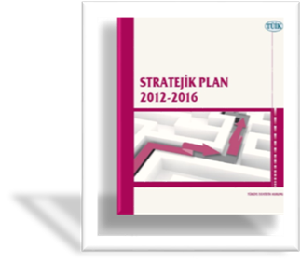
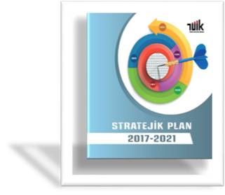
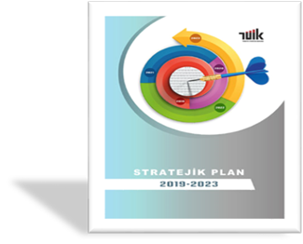
Statistical Infrastructure Strategic Plan
2007-2011 Strategic Plan
2012-2016 Strategic Plan
2017-2021 Strategic Plan
2019-2023 Strategic Plan (in progress)
2024-2028 Strategic Plan (preparation work in progress)

Slide 3
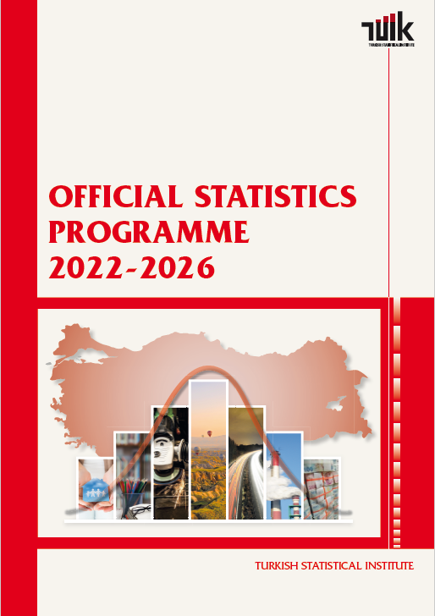
Statistical Infrastructure Current State of the Official Statistics Programme
The 4th Official Statistics Programme (OSP) (2022-2026) has been published in the Official Gazette on December 31, 2021.
Focus on strengthen data integration
Make progress in digitalization and use of alternative data sources
Routine monitoring studies of the five-year programme of the official statistics (2022-2026),
OSP Monitoring Platform has been established to monitor the official statistics.
Official statistics portal renovation studies have been completed.

Slide 4
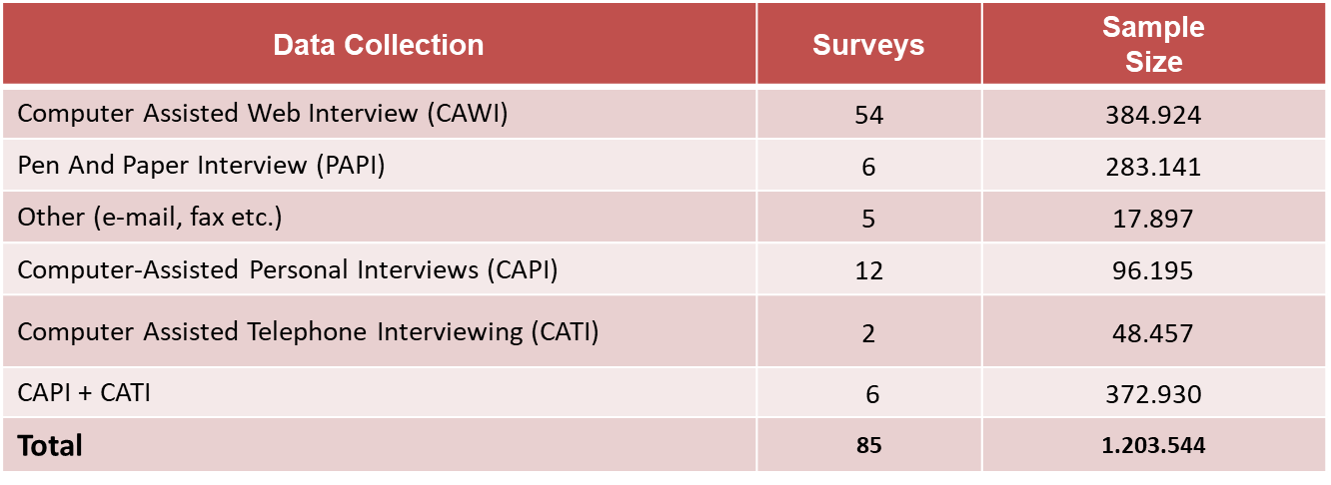
Statistical Infrastructure Data Collection Methods
Surveys

Slide 5
Statistical Infrastructure Data Collection Methods
Administrative Data;
With data transfer protocols signed with other institutions, more than 300 administrative record data are regularly flowed.
Scanner Data and GIS (CPI);
Approximately half of the total number of prices are obtained directly from chain and local markets by integrate the scanner data into Consumer Price Index (CPI).
GIS is used for CPI fieldwork quality control checks (in order to compare recorded enterprise address and GIS location.
The data collected on a daily basis by web scraping is divided into two categories: prices and careers:
Data on prices of items such as white goods, cars, furniture, bus and flight tickets, and clothing are collected from 67 different websites.
Job postings from 14 career websites are collected as part of the career-related data collection process.
It is planned to increase the number of web scraping product websites.

Slide 6
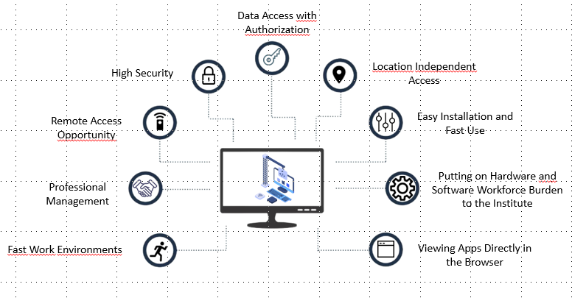
Statistical Infrastructure Data Dissemination
Electronic Data Research Center (E-DRC)
Enables remote access to micro data
It is a virtual environment where studies can be done on microdata by connecting to applications and desktop software allowed by administrators through the browser
Thanks to the fast and easy created virtual work environments, users can perform their analyzes without worrying about performance
Future plans regarding E-DRC;
Data masking and data hiding tools are planned to be integrated into the system
Anonymized microdata of all official statistics produced by the government is planned to be made available to users via E-DRC

Slide 7
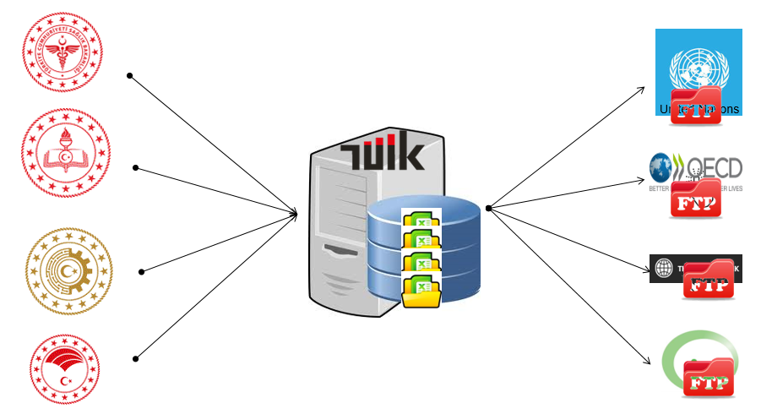
Statistical Infrastructure Data Transmission with IDTS
With IDTS, TurkStat coordinates data transmission to international organizations

Slide 8
Statistical Infrastructure Classifications
Implementation of latest version of classifications and adopting correspondence tables
The latest versions of NACE, CPA, HS, CN, ISCO, ISCED, GEONOM are put into use and available on the Classification Server
Participating in ISIC, CPC, NACE, CPA revision and global consultation of the International Classification of Violence Against Children (ICVAC)
Designing new classification server
For the usability, accessibility, fate, security and manageability of the classifications.
Internal projects regarding economic and social classifications

Slide 9
Macroeconomic Statistics International Trade
Türkiye produces highly compliant statistics on international trade in goods (ITGS).
Studies for the production of cross-border e-trade in goods data are going on.
International trade in services statistics (ITSS) will be highly compliant with the regulations with the compilation of travel item on country level,
TurkStat compiled Outward FATS for the 2016-2021 reference years and published in April 2023.
TurkStat is continuing studies on compilation of Inward FATS (IFATS) for the 2016-2022 reference years. It is expected to be completed by the end of 2023.
By finalising the compilation of IFATS, «Services trade by enterprise characteristics (STEC)» will be produced for the 2016-2022 reference years, by the end of 2023.

Slide 10
Macroeconomic Statistics Price Statistics
Transition to tablet computers for field data collection
Enlarged sample size for ‘’Actual rentals for housing’’ data
Daily collection of data on fuel, gold, and electricity
Weekly collection of daily barcode scanner data from chain markets
Barcode scanner data contributes 46 % to Harmonised Index of Consumer Prices (HICP) data
Web scraping
Web scraping data contributes 4 % to HICP data

Slide 11
Tourism Statistics
TurkStat focused on studies to obtain data from different data sources;
Within the scope of the revision; The Departing Visitor Survey will continue to be used with additional data sources and the regulation regarding the number of overnight stays in the package tour has been integrated.
Interbank Card Center data has been integrated into the system.
The results of the Health Tourism Survey were used to obtain health tourism data.
The results of the Education Tourism Survey for the acquisition of educational tourism data and the fees paid by the students studying within the scope of the international student quota (Turkish, foreign) have been compiled and the results have been integrated.

Slide 12
Social Statistics
Education Statistics:
Press release on ‘Higher Education Employment Indicators’ was announced to the public in August 2022 and June 2023 for the first and second time, based on the Education-Employment Database.
‘Mean years of schooling’ indicator was calculated for the first time and published in May 2023 in national and provincial levels.
Health and Social Protection Statistics
Türkiye Health Survey (THS) for the reference year 2022 was implemented. The main results of the survey were published as a press release in June 2023.
The next implementation of Türkiye Health Survey (THS) is going to be conducted in 2025 by using third wave of EHIS (European Health Interview Survey) questionnaire together with additional questions based on country-specific needs.

Slide 13
Social Statistics Population and Housing Census (PHC)
2021 Population and Housing Census (PHC) Final Results:
Basic source and frame of 2021 Census was the Address Based Population Registration System (ABPRS) data. Thus, greater part of the information to be produced within the scope of 2021 Census were already disseminated on February 4, 2022.
Within the scope of 2021 Census, information on the reason for internal migration was produced for the first time based on administrative registers.
Together with the census-type labour force and housing characteristics, final results of 2021 Census were announced to the public on December 19, 2022.
For census-type labour force characteristics, the target in the first step was to set up an integrated database called “Population Characteristics Database (PCDB)”.

Slide 14
Social Statistics Population Statistics Portal
Population Statistics Portal has been established and opened to the public access in April 2023,
To provide a holistic, clear and user-oriented data presentation by sharing demographic and socio-economic historical data on population through visualization tools
To increase accessibility, public awareness and statistical literacy regarding the population and migration statistics.
Türkiye Child Survey, was carried out for the first time in 2022 and first results were disseminated by a Press Release on 22 March 2023.
Türkiye Family Structure Survey was carried out in order to determine the family structure and results were published in April 2022.

Slide 15
Sectoral Statistics
Preliminary studies for Household Energy Statistics Survey is planned to be complemented in August and the results will be disseminated on December 2023.
Revision of Research and Development Statistics is in line with Frascati Manual.
Regarding construction statistics, studies are going on in order to use administrative registers for the office sales statistics. The results are planned to be published at the beginning of 2024.

Slide 16
Enviromental Statistics and SDG Indicators
The latest Turkish Greenhouse Gas (GHG) Inventory was submitted on 14 April 2023, results are also submitted to the European Environment Agency (EEA).
Significant quality improvements in terms of transparency, timeliness, completeness, consistency and accuracy has been achieved in GHG inventory of Türkiye.
The methodological improvements on new modules of environmental accounts have been followed and the studies have been started. (such as ecosystem accounts.)
In the scope of environmental accounts, TurkStat took the first step on producing ecosystem accounts by starting a pilot project with Ministry of Agriculture and Forestry under the coordination of UN and World Bank in the last quarter of the 2022.
The number of global SDG indicators published by TurkStat grew annually starting from 83 in 2019, 100 and 131 in 2020 and 2021 respectively.
In 2022, TurkStat launched the SDG portal reported a total of 148 unique indicators. 19 indicators were presented with geocoded data on maps, and 4 indicators were calculated using GIS.

Slide 17
Enviromental Statistics
TurkStat has been reporting waste/water statistics and environmental accounts in line with the EU definitions and standards.
The administrative registers have been analyzed to be used to improve the data availability of waste and water statistics.
The methodology of the calculation of «municipal waste recovery rate» has been improved to be published at the end of 2023.
The studies on the methodology developed by UNSD to monitor the global set of climate change related indicators are planned to be started this year.

Slide 18
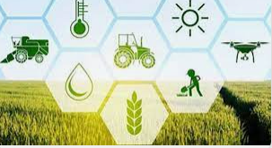
Agricultural Statistics
TurkStat continues to work for the ultimate goal of implementing an Agricultural Census in compliant with international standards. For this purpose;
Work on integrating administrative registers and spatial data to build a sampling frame has been continued.
The priority is to eliminate the under coverage in the list of agricultural holdings before the census. The second half of 2023 and the first half of 2024 will be devoted to this task through different data collection methods (CATI, CAPI, etc).
For those studies TurkStat and Ministry of Agriculture and Forestry (MoAF) cooperate closely.
In this regard, MoAF is in an effort to create a full-scope registration system with the impetus provided by the legislative change on Agricultural Law, which rules about the planning of agricultural production for agricultural basin/holding level.

Slide 19
Thanks for your attention!

